Slide 1
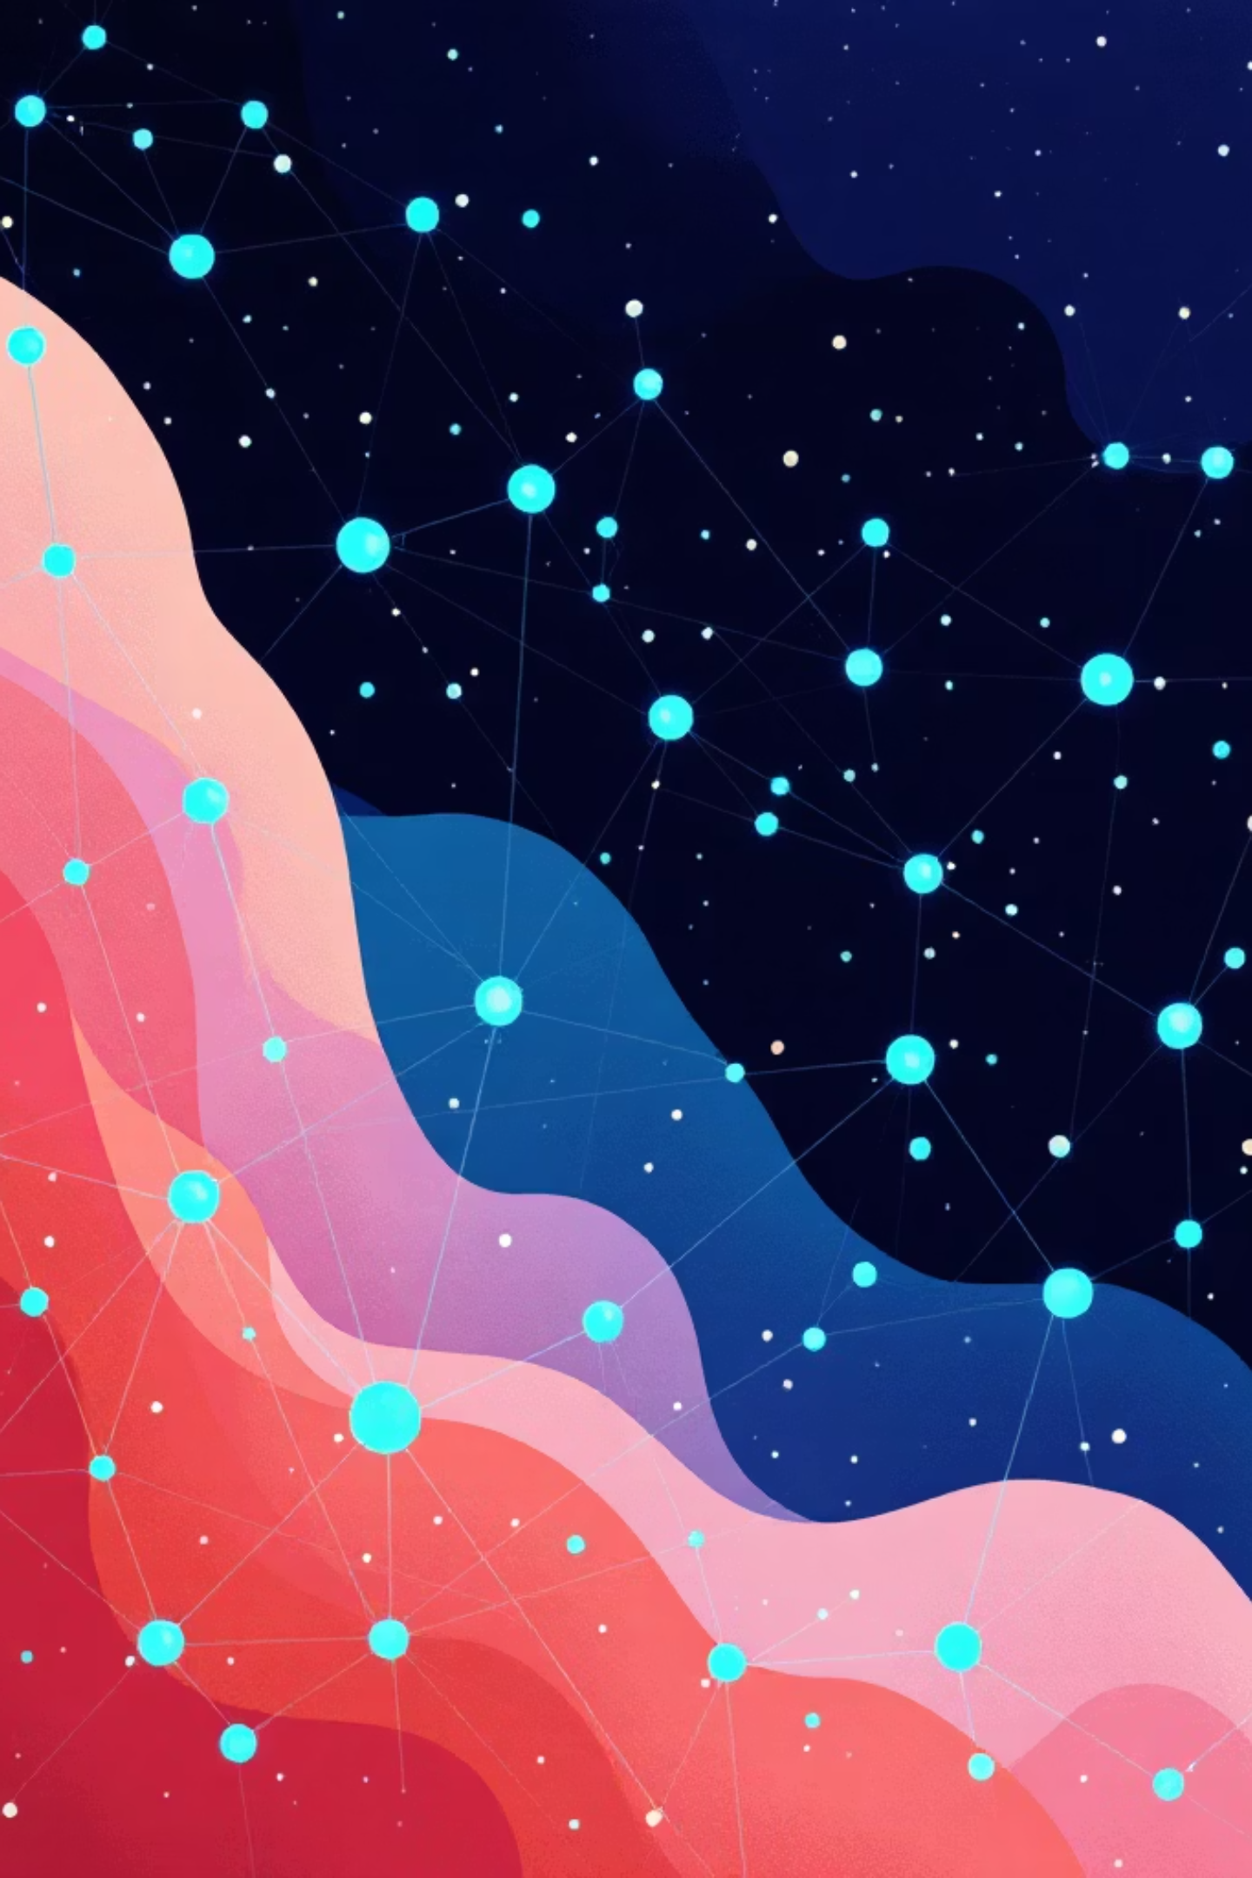
Machine Learning for Business
A practical guide to supervised and unsupervised ML — covering real-world use cases across banking, retail, and SaaS, with deep dives into fraud detection, customer segmentation, and churn prediction.
ML FUNDAMENTALS
BANKING · RETAIL · SAAS

Slide 2




My Career
2021 - Current
McDonald, Data Scientist
2015 - 2020
Synchrony Financial, Analytics & Data Science
2012 - 2015
Environmental System Design, Marketing Analyst
2010 - 2012
DePaul, MS, Marketing Analytics

Slide 3
Supervised vs. Unsupervised ML
Two foundational paradigms power most business ML applications — each suited to different types of questions.
Supervised Learning
Unsupervised Learning
Trains on labeled data to predict a known outcome. The model learns the relationship between inputs and a target variable.
Finds hidden structure in unlabeled data. No predefined outcome — the model discovers patterns on its own.
Customer segmentation
Anomaly / fraud pattern mining
Behavior clustering
Fraud detection (fraud / not fraud)
Churn prediction (will churn / won't)
Credit scoring (default risk)
Why Supervised?
Why Unsupervised?
Drives actionable decisions — approve a loan, trigger a retention offer, flag a transaction — with measurable accuracy and ROI.
Unlocks discovery — reveals customer groups, risk tiers, and behavioral patterns that humans wouldn't think to define upfront.

Slide 4

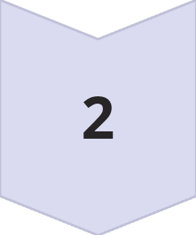

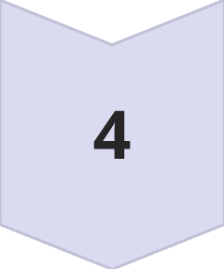

The Revenue Lifecycle Framework
ML models create value at every stage of the customer journey. Mapping models to lifecycle stages ensures effort is focused where it drives measurable business outcomes.
Acquisition
Credit models, conversion prediction, persona clustering
Conversion
Approval models, price elasticity, uplift modeling
Monetization
Fraud detection, demand forecasting, feature scoring
Retention
Churn prediction, behavior clustering, repeat visit models
Expansion
Cross-sell uplift, upsell prediction, CLV modeling

Slide 5

Banking: ML Use Cases by Lifecycle Stage
Banks generate revenue through interest income, interchange fees, annual fees, and cross-sell products — each stage of the customer lifecycle maps to distinct ML applications.
Stage
Supervised
Unsupervised
Acquisition
Credit approval model
Applicant clustering
Risk
Default prediction
Risk segment discovery
Transactions
Fraud detection
Fraud pattern mining
Retention
Churn prediction
Behavior clustering
Growth
Cross-sell uplift model
Spending pattern clusters
Lifecycle flow: Acquisition → Approval → Spend → Retain → Cross-sell. ML creates value at every transition point.

Slide 6
Deep Dive: Fraud Detection (Supervised)
BANKING USE CASE
Business situation: Every fraudulent transaction erodes margin and damages trust. The model predicts in real time whether a transaction should be approved, reviewed, or blocked.
Data Structure & Target Variable
Key Modeling Considerations
Target: Binary — Fraud (1) / Not Fraud (0)
Unit of analysis: One row per transaction
Transaction amount, merchant category, time of day
Location delta from prior transaction
Device fingerprint, velocity (transactions/hour)
Historical spend patterns per cardholder
Imbalanced Data
Model Evaluation
Fraud may be <0.1% of transactions. Use SMOTE, class weighting, or anomaly hybrid approaches.
Prioritize Precision-Recall AUC and F1 over accuracy. False negatives (missed fraud) are far costlier.
Preferred Models
XGBoost, LightGBM, Isolation Forest (hybrid), Neural Nets for high-volume real-time scoring.

Slide 7
Retail: ML Use Cases by Lifecycle Stage
Retail revenue is driven by Guest Count × Average Check. ML optimizes every lever — from driving traffic to growing basket size and repeat visits.
Stage
Supervised
Unsupervised
Traffic
Demand forecasting
Store segmentation
Pricing
Price elasticity model
Price sensitivity clusters
Promotion
Uplift modeling
Promo response segmentation
Retention
Repeat visit prediction
Behavior clustering
Operations
Inventory forecast
Store similarity clustering
High-impact outputs: CLV scoring, propensity models, and promo targeting typically deliver 5–15% lift in campaign ROI.

Slide 8
Deep Dive: Customer Segmentation (Unsupervised)
RETAIL USE CASE
Business situation: Not all customers are equal. Segmentation reveals distinct behavioral groups so marketing, pricing, and retention strategies can be personalized at scale.
Data & RFM Features
Segment Profiles & Evaluation
Target: No label — cluster membership is the output
Recency: Days since last purchase
Frequency: Number of visits / transactions
Monetary: Total and average spend
Category mix, channel preference, promo sensitivity
Champions
At-Risk
High RFM — VIP treatment, loyalty rewards
High past spend, low recency — win-back campaigns
New Shoppers
Evaluation
Low frequency — onboarding and education
Silhouette score, elbow method (K-Means), business interpretability

Slide 9
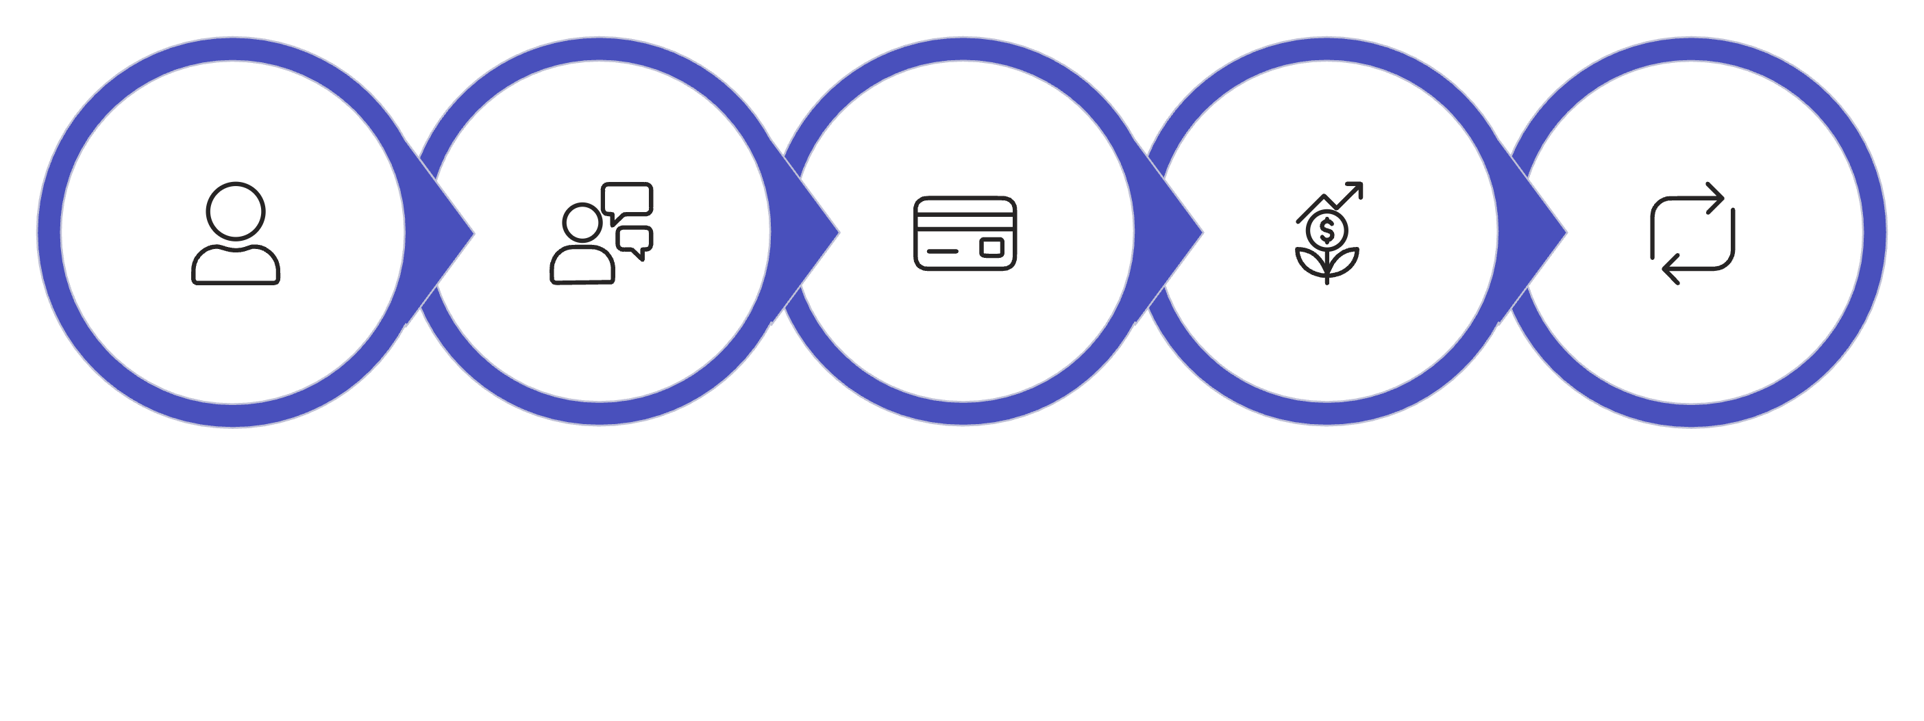





SaaS: ML Use Cases by Lifecycle Stage
SaaS revenue is built on MRR, annual contracts, add-ons, and usage-based pricing. ML drives conversion, reduces churn, and identifies expansion opportunities across the subscription lifecycle.
Stage
Supervised
Unsupervised
Acquisition
Conversion prediction
User persona clustering
Engagement
Feature usage prediction
Behavior segmentation
Retention
Churn prediction
Usage pattern clusters
Expansion
Upsell prediction
Account maturity clustering
Free Trial
Conversion
Subscription
Expansion
Renewal

Slide 10
Deep Dive: Churn Prediction (Supervised)
SAAS USE CASE
Business situation: In SaaS, losing a subscriber erodes MRR permanently. A 30-day churn prediction model gives customer success teams time to intervene before cancellation.
Data Structure & Target Variable
Segment Profiles & Model Evaluation
Target: Binary — Will cancel in next 30 days (1 / 0)
Login frequency and session duration trends
Feature adoption depth (core vs. advanced features)
Support ticket volume and sentiment
Days since last active, contract age, plan tier
NPS score, billing history, seat utilization
High-Risk Segment
Medium-Risk Segment
Declining logins + open tickets → immediate CSM outreach
Low feature adoption → targeted onboarding nudges
Model Evaluation
Preferred Models
Use Recall to minimize missed churners; calibrate threshold by intervention cost vs. LTV of saved accounts.
Logistic Regression (baseline), XGBoost, Survival Analysis for time-to-churn.

Slide 11

Key Takeaways
1
Match the method to the question
Use supervised ML when you have a defined outcome to predict. Use unsupervised ML to discover hidden structure and generate hypotheses.
2
Map models to the revenue lifecycle
Every stage — acquisition through expansion — has high-value ML applications. Prioritize where model output directly moves a business metric.
3
Master the fundamentals first
Fraud detection, churn prediction, and customer segmentation are the highest-ROI starting points across banking, retail, and SaaS.
4
Evaluate models on business impact
Accuracy alone misleads. Choose metrics — Precision-Recall, Recall, Silhouette — that reflect the real cost of model errors in your context.

